Slide 1

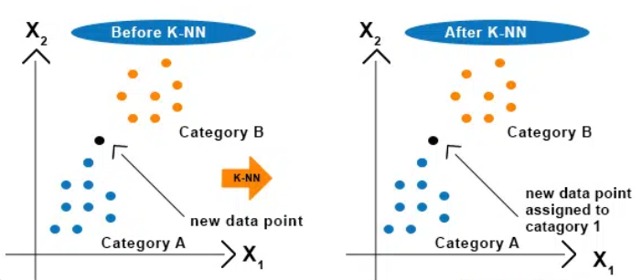
ML2223-15 Investigate and Implement KNN Classifier
Prepared By Team_KNN:
Ankush Laxman Patil()
Nasir Ishaq(1444979)
Ayan Borthakur()

Slide 2
Index
Introduction
Methodology
Flow chart of Implementation
Results
Conclusion

Slide 3
Introduction
K-Nearest-Neighbors(KNN) classifier is a supervised machine learning algorithm which performs label-based predictions with high accuracy.
It works by finding the K-nearest neighbors to new input sample in the training dataset based on distance metric.
Distance metric can be Euclidean distance, Manhattan Distance, Minkowski Distance, Cosine Distance, Mahalanobis Distance
Euclidean Distance method is used in this project

Slide 4
Introduction
KNN classifier has three important parts
Calculations of the distance of uncategorical label data with different techniques from surrounding points
Decide the value of K
Give prediction based on voting table for uncategorical data

Slide 5
Methodology

Slide 6
Methodology

Slide 7
Methodology

Slide 8
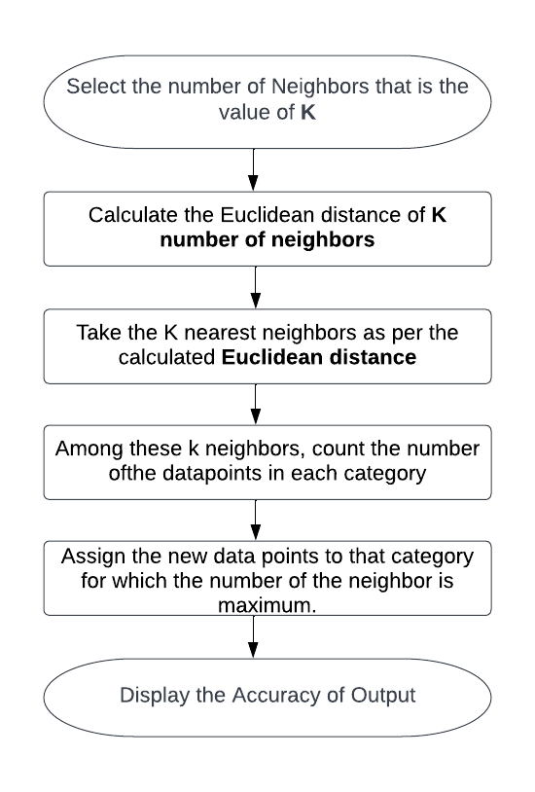
Flow chart of Implementation:

Slide 9
Results

Slide 10
Results

Slide 11
Results

Slide 12
Results

Slide 13
Conclusion

